Slide 1
Geog 10001: The Geography of Scarcity Virtual Water & Conclusion
Dr. Brian Cook
School of Geography
brian.cook@unimelb.edu.au

Slide 2

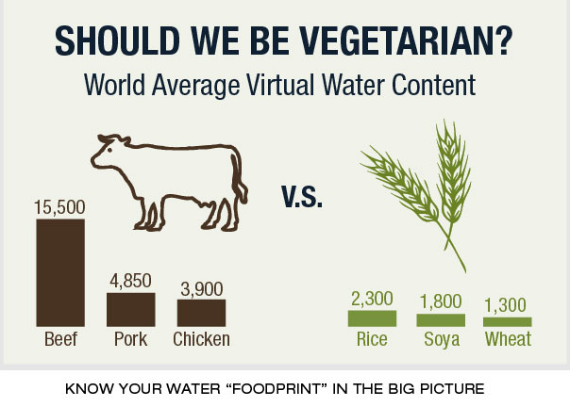

Today we will cover…
Who is a vegetarian?
Virtual Water

Slide 3
TYPES OF WATER

Slide 4
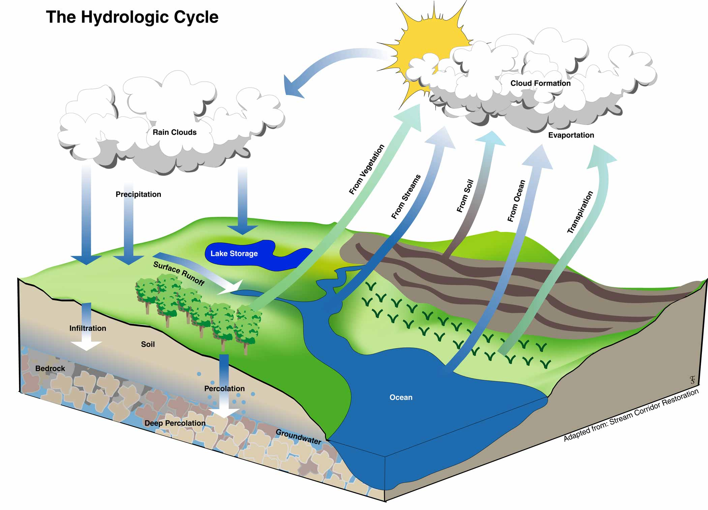
Notes:
Recall the hydrological process… it leads to several ‘types’ of water.

Slide 5
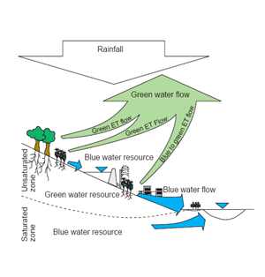
Water Scarcity
What it is
Blue water is ground and surface water (e.g. rivers, lakes).
Green water is rainwater stored in soil (i.e. soil moisture content).
Gray water is polluted water (through agriculture, industry and human use).

Slide 6
“Green water is ignored by engineers because they can't pipe or pump it, by economists because they can't price it, and by governments because they can't tax it” (http://www.isric.org)

Slide 7
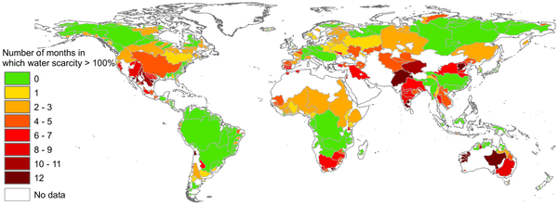

Figure 4. Number of months during the year in which the blue water footprint exceeds blue water availability for the world's major river basins, based on the period of 1996–2005.
Hoekstra AY, Mekonnen MM, Chapagain AK, Mathews RE, et al. (2012) Global Monthly Water Scarcity: Blue Water Footprints versus Blue Water Availability. PLoS ONE 7(2): e32688. doi:10.1371/journal.pone.0032688
http://www.plosone.org/article/info:doi/10.1371/journal.pone.0032688

Slide 8
VIRTUAL WATER

Slide 9
Notes:
What does 2500 liters of water look like?
Beef
The global average water footprint of beef is 15400 liter/kg. This is predominantly green water (94%). The water footprint related to the animal feed takes by far the largest share (99%) in the total water footprint of beef. Drinking and service water contribute only 1% toward the total water footprint, but 30% to the blue water footprint. The major fraction (83%) of the water footprint of a beef cow is attributed to the derived beef, but smaller fractions go to the other products: offal, leather and semen.
One piece of beef can be very different from another piece. The precise water footprint of beef strongly depends on the production system from which the beef is derived (grazing, mixed or industrial), the composition of the feed and the origin of the feed. Due to the large feed conversion efficiency, beef from industrial systems generally has a lower total water footprint than beef from mixed or grazing systems. But due to the larger fraction of concentrates in the feed of cattle in industrial systems and the fact that concentrates have a larger water footprint than roughages, industrial beef has generally larger blue and grey water footprints than beef from mixed or grazing systems. Given the fact that freshwater problems mostly relate to blue water scarcity and water pollution and to a lesser extent to competition over green water, this means that grazing systems are preferable over industrial production systems from a water resources point of view.
The water footprint of meat from beef cattle (15400 liter/kg as a global average) is much larger than the footprints of meat from sheep (10400 liter/kg), pig (6000 liter/kg), goat (5500 liter/kg) or chicken (4300 liter/kg).
Per kilogram of product, animal products generally have a larger water footprint than crop products. The same is true when we look at the water footprint per calorie or protein. The average water footprint per calorie for beef is twenty times larger than for cereals and starchy roots. The average water footprint per gram of protein in the case of beef is six times larger than for pulses.
The global water footprint of beef production in the period 1996-2005 was about 800 billion m3/yr, which was one third of the total water footprint of animal production in the world (all farm animals) (Kekkonen and Hoekstra, 2010, 2012).

Slide 10
Virtual (water) Relations
“More than most commodities, staple foods, which are very important indeed as a proportion of world trade, are inextricably political. People have a deep intuitive aversion to being dependent on other economies for their water and also for their food” (Merrett et al. 2003: 8).
“Awareness of a dependence on water and staple food coming from outside their own sovereign territories can be very destabilising. Because virtual water is economically invisible and politically silent it has the wondrous virtue of making it possible for water policy-makers and managers to cultivate a policy discourse where it can be assumed that there is no national water or food deficit” (Merrett et al. 2003: 8).

Slide 11
How Virtual Water Shapes ‘Water Scarcity’
“In addition to its three major virtues of being first very effective indeed in addressing water deficits, it is secondly economically invisible, and thirdly, politically silent. Virtual water has a fourth very important quality. Water embedded in food commodities can be mobilized very quickly and flexibly to remedy the ever-changing demands of those enduring water and staple food deficits” (Merrett et al. 2003: 7).
Notes:
Can anyone think of another way that a virtual ‘something’ addresses scarcity? (Labour).

Slide 12
Virtual Water & Water Wars (scarcity-induced conflicts)
“Virtual water played havoc with the narrow, environmentally deterministic assumptions on which such specialists generally based their analyses. All the analysts who have conjured the prospect of water wars have ignored the role of virtual water in ameliorating regional water deficits” (Merrett et al. 2003: 7).
“a ton of wheat when imported by a water short political economy enables those managing scarce water in such economies to escape the economic and political stress of mobilising 1,000 tons (cubic meters) of water” (Merrett et al. 2003: 9).
Environmental determinism: the notion that the physical environment has a massive and often controlling (and perhaps never-changing and generationally stable) affect on human beings, in essence dictating their abilities in all realms of life and society.

Slide 13
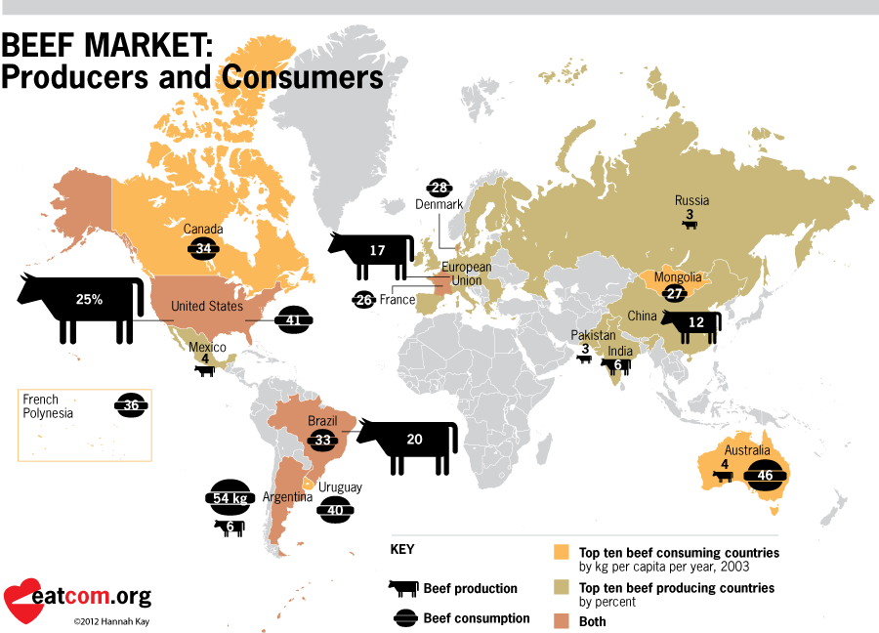
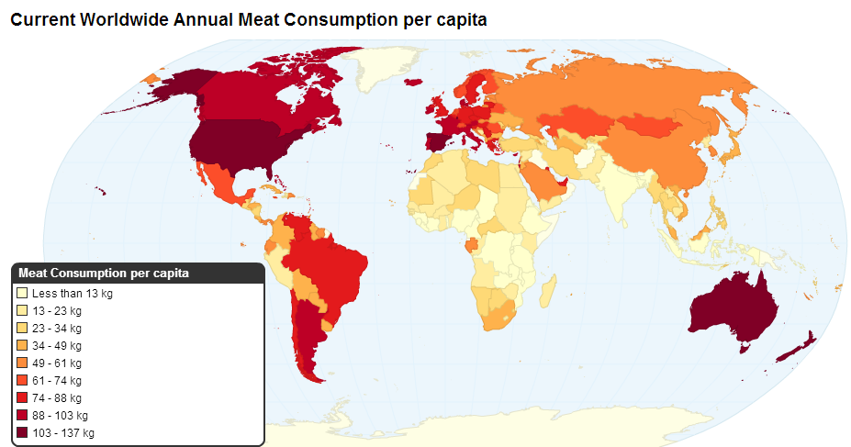
How does Virtual Water link to Scarcity?
Notes:
Can anyone think of another way that a virtual ‘something’ addresses scarcity? (Labour).

Slide 14
AUSTRALIAN VIRTUAL WATER: ANALYSIS

Slide 15

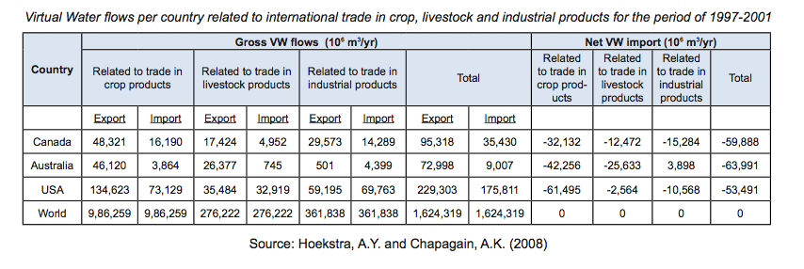
4. Apply Concepts: Australia
“The driest inhabited continent on earth - also the world’s biggest water exporter!”
(ttp://candobetter.net/node/2481)
Notes:
http://www.youtube.com/watch?v=MqI5VhE5Lsc

Slide 16
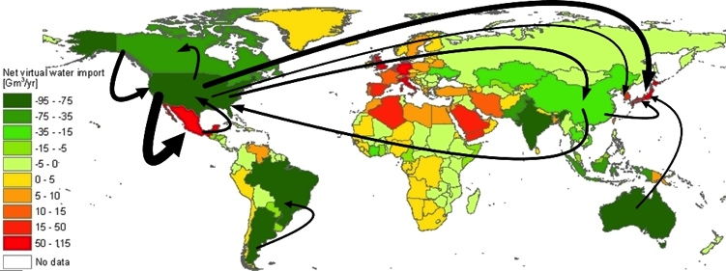
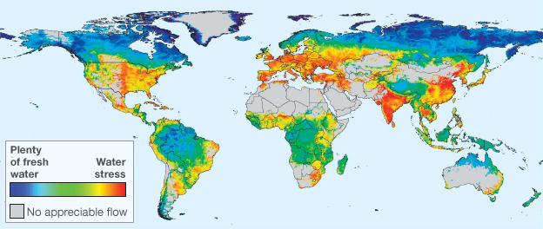
Who Imports Virtual Water
Green exports water, red imports water.
The arrows show scale of virtual water movement.

Slide 17
Water Diversions for Food
In Australia, water is taken from rural streams to produce food to feed people in cities. Eighty five percent of the divertible water from the Murray-Darling system is now diverted, and only 7 of Victoria’s 29 major catchments are not fully allocated for water” (Rutherfurd 2007: 348).
“In Victoria, 75% of that diverted water is being used for agriculture, and about 12% for urban domestic purposes. The great bulk of water used in agriculture goes toward irrigation, and mostly irrigation of pasture for dairy and beef cows” (Rutherfurd 2007: 348).
“as consumers of agricultural products produced in rural areas, urban people are, in large part, responsible for the consequences of that production. Urban consumers very much drive the condition of rural streams through their food choices” (Rutherfurd 2007: 348).
“Meyer (1997) estimated that 1Kg of Australian beef requires an astonishing 100,000L of water to produce, and 1Kg of butter, requires 18,000L of water” (Rutherfurd 2007: 348).
Notes:
Consumers drive scarcity elsewhere…

Slide 18
SUMMARY & CONCLUSION

Slide 19
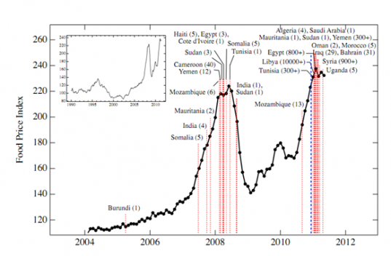
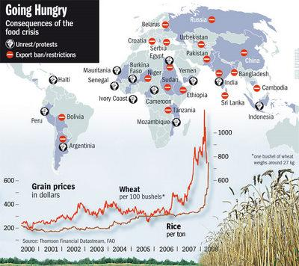
Scarcity Conflicts?
How sure are we about our views on scarcity-induced conflicts?

Slide 20
Key Points from Today
Make water not war…
Types of water
Virtual water
Virtual water in the context of scarcity and conflict
Australian examples

Slide 21
Final Exam Question

Slide 22
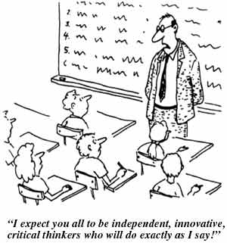
Questions or Concerns
Last chance?

Slide 23
Sources & Further Reading
Allan, J. A. 2011. Virtual Water: tackling the threat to our planet's most precious resource. London, I.B.Tauris.
Amery, H. A. and Wolf, A. T. 2000. Water in the Middle East: a geography of peace, University of Texas Press Austin.
Brock, L., Homer-Dixon, T., Perelet, R., Vlachos, E. and Gleditsch, N. 1997. Conflict and the Environment, Springer.
Chapagain, A. K. and Hoekstra, A. Y. 2008. The global component of freshwater demand and supply: an assessment of virtual water flows between nations as a result of trade in agricultural and industrial products. Water International 33(1): 19-32.
Chellaney, B. 2011. Water: Asia's New Battleground. Washington D.C., Georgetown University Press.
Gleick, P. H. 1993. WATER AND CONFLICT - FRESH-WATER RESOURCES AND INTERNATIONAL SECURITY. International Security 18(1): 79-112.
--- 1998. Water in crisis: Paths to sustainable water use. Ecological Applications 8(3): 571-579.
--- 2000. The changing water paradigm: A look at twenty-first century water resources development. Water International 25(1): 127-138.
--- 2002. Water management - Soft water paths. Nature 418(6896): 373-373.
Gleick, P. H. and Lane, J. 2005. Large international water meetings: Time for a reappraisal - A water forum contribution. Water International 30(3): 410-414.
Hoekstra, A. Y. and Hung, P. Q. 2005. Globalisation of water resources: international virtual water flows in relation to crop trade. Global Environmental Change-Human And Policy Dimensions 15(1): 45-56.
Ma, J., Hoekstra, A. Y., Wang, H., Chapagain, A. K. and Wang, D. 2006. Virtual versus real water transfers within China. Philosophical Transactions of the Royal Society B-Biological Sciences 361(1469): 835-842.
Rutherfurd, I. (2007) City people eat rivers: estimating the virtual water consumed by people in a large Australian city.
Seekell, D. A., D'Odorico, P. and Pace, M. L. 2011. Virtual water transfers unlikely to redress inequality in global water use. Environmental Research Letters 6(2).
348
Wilson, A.L., Dehaan, R.L., Watts, R.J., Page, K.J., Bowmer, K.H., & Curtis, A. (2007). Proceedings of the 5th Australian Stream Management Conference. Australian rivers: making a difference. Charles Sturt University, Thurgoona, New South Wales.
Wolf, A. T. 1998. Conflict and cooperation along international waterways. Water Policy 1(2): 251-265.
Wolf, A. T. 1999. "Water wars" and water reality: Conflict and cooperation along international waterways. Environmental Change, Adaptation, And Security 65: 251-265.

